Slide 1
Maintenance Management and the Department
Eric Baggett- Maintenance Management Specialist
Raymond Leung – Staff Maintenance Engineer

Slide 2
Maintenance Management
All actions that managers undertake in their daily responsibilities of overseeing the maintenance program
Maintenance Management System
The set of tools, technologies, and processes that help managers make better decisions and manage more effectively
Notes:
Lately there has been a lot of interest in DOT’s to get or upgrade their maintenance management systems to help make their dollars go further.(Need to add here)
What is maintenance management?
Maintenance management is basically everything we do as a manager to maintain our roads. From administration to customer service and everything in between.
Maintenance Management system is all the tools and processes that managers use to make their decisions. This includes spreadsheets, programs, workflows, and reports that are used.

Slide 3
Different levels of MMS implementation
MMS Implementation Level | System Features and Management Capabilities
Tier 1 – Basic MMS | Output based planning = work units Budgeting based on annual plan for work units or historical data Tracking of expenditures and work units
Tier 2 – Stovepipe Systems | LOS descriptions Asset collection and maintenance quality assessments Analysis to determine pavement and bridge treatments and strategies Customer feedback
Tier 3 – Cross-Functional Performance Measures | Establishing performance targets Ability to link resources and budget with desired outcomes and results Performance-based planning and budgeting Ability to link customer input with resource and budget needs.
Tier 4 – Full Integration | Goal setting across transportation needs Enterprise-wide trade-off analysis Fully integrated decision-support system.
Tier 5 – Investment Optimization | Ability to optimize maintenance tradeoffs Investment analysis = system expansion vs. preservation vs. maintenance
Notes:
These are the different levels of implementation for an MMS
Tier 1 is basic budgeting, planning, work reporting, and monitoring. This is Where you have the ability to track costs, create work plans, and schedule
Tier 2 is where we have a bunch of stovepipe systems such as pavement management, bridge management, condition rating, and customer feedback systems that are not connected with each other. Managers can access to help plan their work but do not necessarily do it. Level of service descriptions and are developed at this stage.
Tier 3 is where performance measures and performance targets enter the picture. Workplans and budgets are linked to results at this stage.
start being linked directly to maintenance performance and targets.
Tier 4 finishes what was started in Tier 3, the MMS is fully integrated with the business process of asset management. Management has the ability to perform trade-off analyses across the various functions of the department.
Tier 5 is where we implement the tools to allow investment optimization across more than just maintenance.

Slide 4
Human Resources
Equipment Management
Fiscal Management
Bridge Management
Pavement Management
Misc. Asset Management
MMS

Slide 5
Background
Legacy system
Annual work plan is on the mainframe but unused
Spreadsheets are heavily relied on
Reports are at least 1 month old by the time they are available
Began collection of Maintenance Features Spring of 2017
Minute order to replace was issued in Spring of 2018
Notes:
Slide 4
So where are we at? we are currently have tier 1 and some of the parts of tier 2, but it is just a bit unwieldy. We have a mainframe system that can build an annual work plan that nobody has used in the past 10 years. Work recording is handled by a mix of mainframe and Kronos, reports are a month old by the time they are available. We have a pavement and bridge management system. Our customer feedback is handled by phone or email.

Slide 6
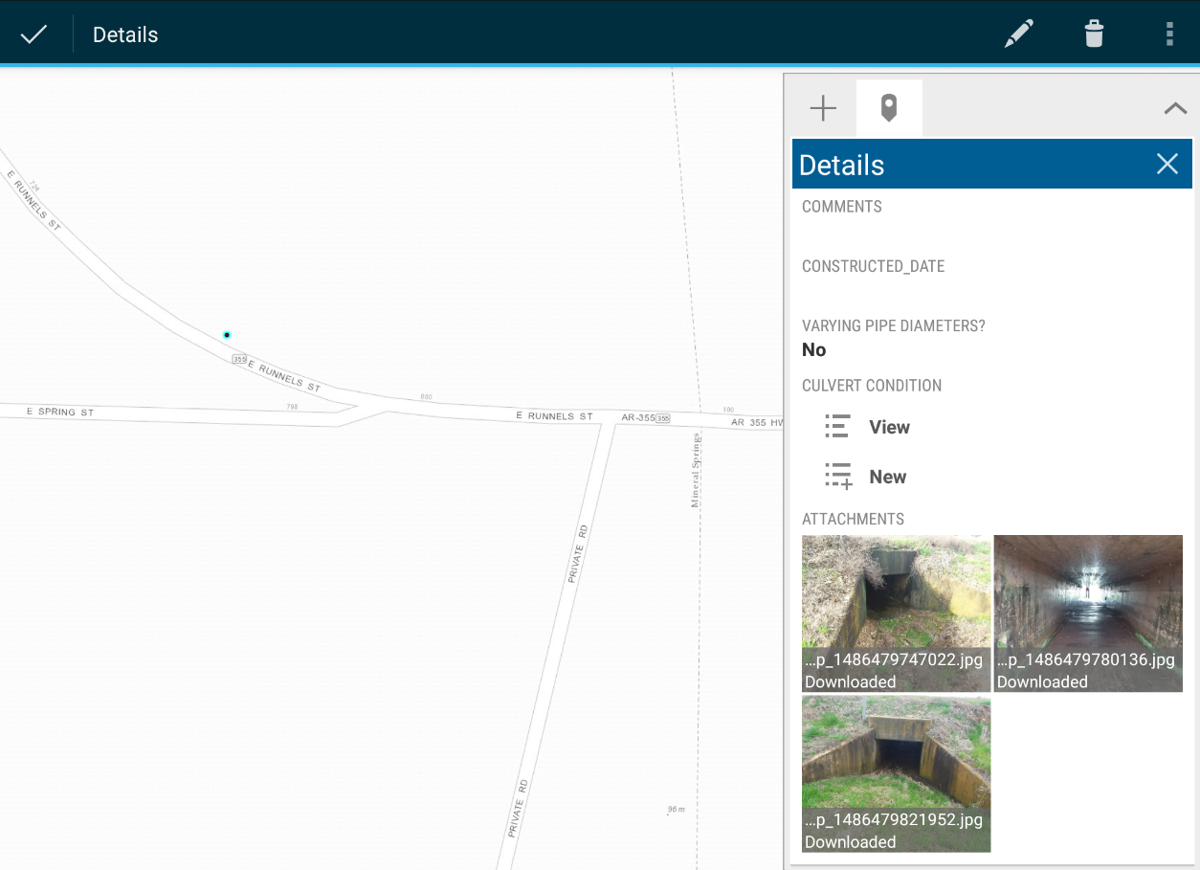
Feature Inventory Using ArcGIS Collector

Slide 7
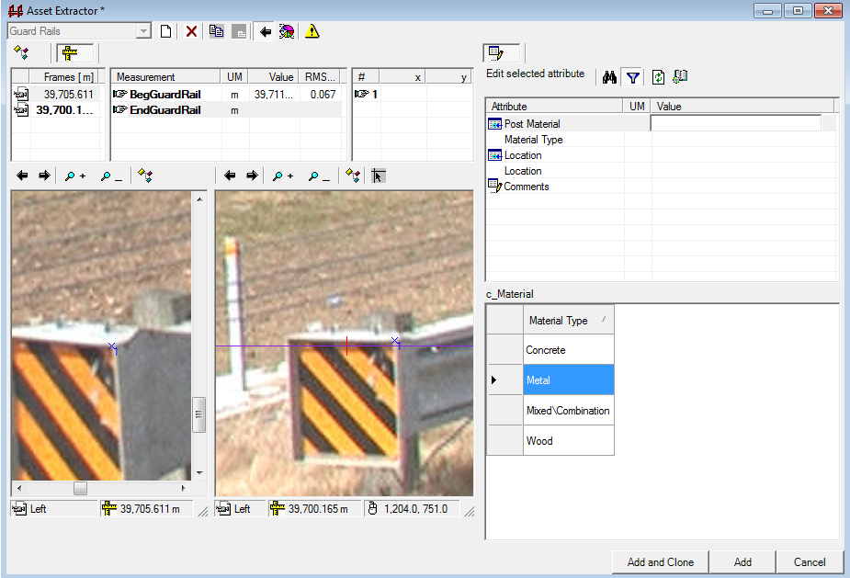
Feature Inventory Using Fugro’s Surveyor Software

Slide 8
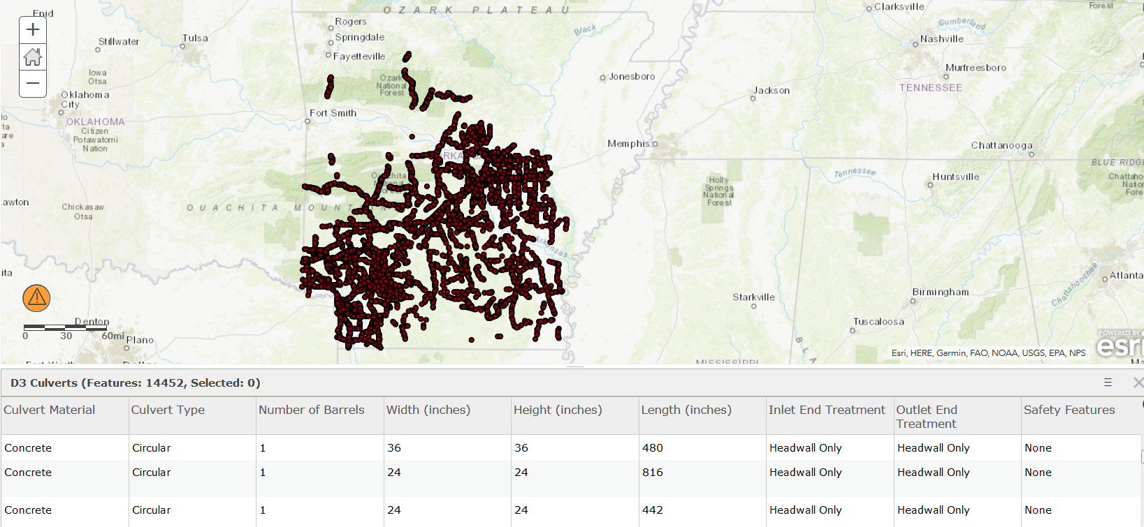
Culvert Feature Inventory

Slide 9
Guardrail Statewide

Slide 10
Where we are
RFP issued on Spring 2019
10 submittals
Demo’s of perspective systems completed May, 2019
Notes:
We currently have an RFP out to get a new software package to implement the MMS with. We have 10 proposals we are vetting.
We are also in the process of determining how to train people not just in how to use the software but in planning and scheduling. This is something many of our guys have not done before so we will need to help them with that.

Slide 11
Current Goals
Tier 1 & Tier 2
Software for annual work plans, scheduling, work orders, and customer feedback
Obtain/develop maintenance management software with work order capability
Determine a scheduling software to facilitate work
Establish planning & scheduling training for crews
Creation of internal/external portal for request
Integration with Department Systems (Fiscal & HR )
Real-time data reporting
Notes:
So what are we up to? Well, we want to get to a tier 5 implementation of an MMS.
What are we doing to try to get there? First, we decided that we are going to do it in two phases. The first phase we are going to shore up tiers 1 and 2 and get to tier 3. Phase 2 will come much later, our current guesstimate is 3 years.
So what are we doing to get there? First thing we want to deal with is planning, scheduling, recording, and monitoring the work we do on an annual basis. And not get reports that are a month out of date when we receive them.
First we want to be able to plan, schedule, and record/monitor the work we do on an annual basis and not wait a month for reports.
Planning
We want to be able to estimate and build out an annual work plan. This will be what the crews can do over the course of the year with the estimated cost and resources required to do that work. We want to get to the point where our budgets are set by the condition of the roads and the expected condition of them after the maintenance.
Scheduling
Next we want to be able to schedule out that work. We want to be able to schedule out the entire annual work plan so when requests come in, people can see the impact the request can have on the schedule of the crews. We also plan to implement work orders and make them available mobile to help make it easier for the crews to know what needs to be done and record the work done.
Reporting/Analysis
We want to use the information we gathered so we can update any asset information and help give more accurate estimates for future work plans
Feature Information
Another thing that needs to be done is to get the conditions of the features we want to work on. Pavement and bridges already have this information, but we do not have this information for any other asset. We will need to determine and develop the level of service for any other features we plan to work on based on condition.

Slide 12
Level of Effort Based Planning & Scheduling

Slide 13
Data Driven Planning and Scheduling

Slide 14
Forward looking
Forthcoming:
Mobile work orders
GIS integration
Integration with Department systems (Pavement Mgmt., Bridge Mgmt.)
Long Term
Deterioration Models
Risk assessments
System optimization

Slide 15
Performance Targets
Notes:
Tiers 3-5 Implementation

Slide 16
Questions?
Eric Baggett
Maintenance Management Specialist
501-569-2654
Eric.Baggett@ARDOT.GOV
Raymond Leung
Staff Maintenance Engineer
501-569-2467
Raymond.Leung@ARDOT.GOV

